Slide 1

Cyclistic Membership Case Study
Author: Tony Ngassi
Last updated: December 8, 2022

Slide 2
Business Task Problem
Analyze historical bike trip data to identify trends in how members and casual riders use Cyclistic bikes.
Design marketing strategies in order to convert Cyclistic’s casual rider to annual member

Slide 3
How do annual members and casual riders use Cyclistics bike differently?

Slide 4
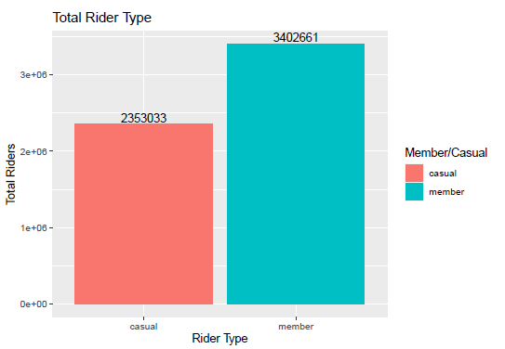
Breakdown of rider type
Over the last year
November 2021 - October 2022

Slide 5
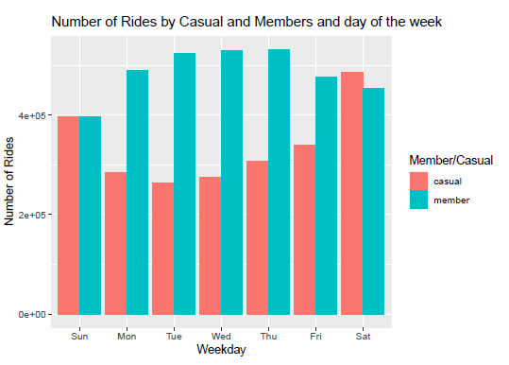
Number of Rides by Casual and Members and day of the week
Member riders take the most rides during the week.
Casual riders are low during the week but higher on the weekends.
Members and Casual riders have the same number of rides on Sunday.

Slide 6
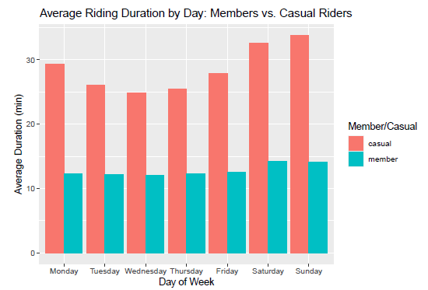
Riding duration by day
Member riders are consistent in their average riding duration. Slight increase on Saturday-Sunday
Casual riders have over double the riding duration
Riding duration is highest on Saturday - Sunday

Slide 7
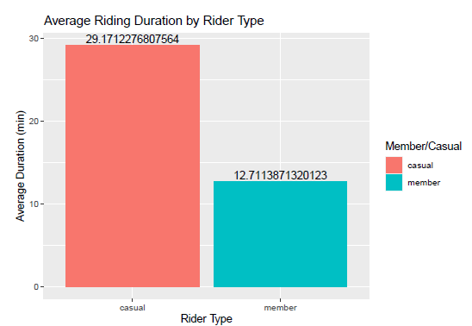
Average Riding Duration
Casual riders have well over double the riding
duration over members.

Slide 8
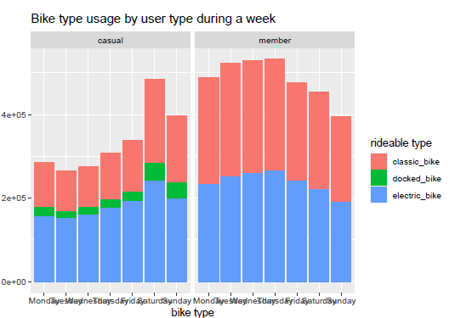
Bike type Usage
Members never use the docked bike, while casual riders do
Casual rider usage peaks on Saturday
Member user is highest Monday - Thursday

Slide 9
How can these findings be used to convert casual riders into members?

Slide 10
Key Findings
Casual riders are most active on the weekends
On average, members take shorter bike riders than casual riders.
Member ride more often on the weekdays.
Member never use Docked bikes, while casual riders do but in very small amounts.
Members are likely riding as commutes, while likely casual ride more the leisure and sightseeing.

Slide 11
Areas of Focus and recommendations
Inform casual riders of the perks of memberships.
Introduce discount for longer rides if you have a membership.
Longer ride could be part of a rewards system. Such as after a certain number of miles, the next ride is free or discounted. This could encourage members to go on longer rides.
Since casual riders are most active on the weekends, a weekend only deal could help attract more casual riders. Alternatively, weekend only deals for members could attract casual riders to signup for a membership.

